Slide 1
Home automation using nodemcu and blynk.
Done by:
A.Jayaram (bt21ece052)

Slide 2
Abstract:
With advancement of Automation technology, life is getting simpler and easier in all aspects. In today's world Automatic systems are being preferred over manual system. With the rapid increase in the number of users of internet over the past decade has made Internet a part and parcel of life, and IoT is the latest and emerging internet technology.
Internet of things is a growing network of everyday object-from industrial machine to consumer goods that can share information and complete tasks while you are busy with other activities. Wireless Home Automation system (HAS) using IoT is a system that uses computers or mobile devices to control basic home functions and features automatically through internet from anywhere around the world, an automated home is sometimes called a smart home. It is meant to save the electric power and human energy.

Slide 3
Home Automation system(HAS) using Blynk Community that employs the integration of cloud networking, wireless communication, to provide the user with remote control of various lights, fans, and appliances within their home and storing the data in the cloud. The system will automatically change on the basis of sensors' data. This system is designed to be low cost and expandable allowing a variety of devices to be controlled.

Slide 4
introduction
IOT or internet of things is an upcoming technology that allows us to control hardware devices through the internet .Here we propose to use IOT in order to control home appliances, thus automating modern homes through the internet.
This system uses 4-loads to demonstrate as house Appliances Controlling. Our user friendly interface allows a user to easily control these home appliances through the internet Worldwide.
For this system we use an NodeMCU (Node Microcontroller Unit). This microcontroller is interfaced with a Relay modem to get user commands over the internet. Relays are used to switch loads. The entire system is powered by a 5V Adaptor/Charger (Micro- type).
After receiving user commands over the internet, NodeMCU processes these instructions to operate these loads accordingly and display the system status on an Smart Phone Display. Thus this system allows for efficient home automation over the internet

Slide 5
Problems definition
Today people are looking at ways and means to better their life-style using the latest technologies that are available.
Any new facility for home appliance that promises to enhance their life-style is grabbed by the consumers. The more such facilities and appliances are added, it becomes inevitable to have easy and convenient methods and means to control and operate these appliances.
Conventional wall switches are located in different parts of a house and thus necessitates manual operations like to switch on or off these switches to control various appliances. It gets virtually impossible to keep track of appliances that are running and also to monitor their Performances. And Aim is to Built an system which controls home appliances with less efforts, like control using mobile, or voice based controlled....

Slide 6
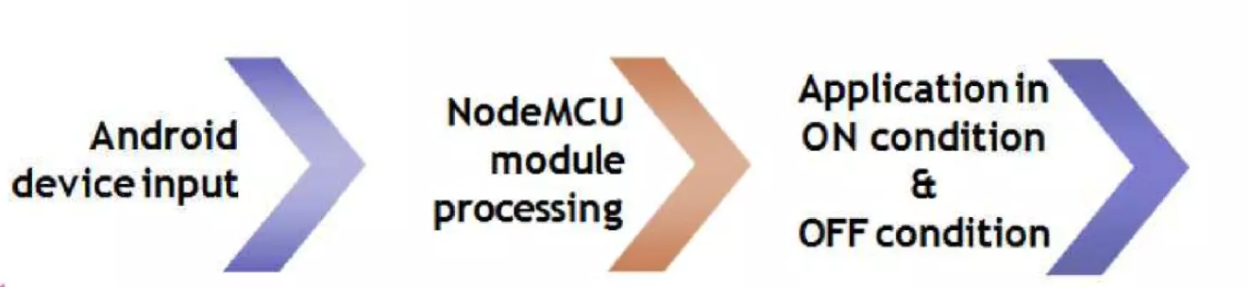
Process of operation

Slide 7
1) Android Device :
The Device used to provide the Commands, Control the Appliances, Switch the Loads over the Internet (Internet of Things) Through Voice Commants Or Swiping on Screen/Display of Smartphones.
2) NodeMCU Processing :
The Heart Of Home Automation, Used to Process the Information /Commands/Instruction provided by the User or Owner, Its function is to Process the data & Pass the signal to the Relay and Switch the loads as per given Input

Slide 8
3) Applications/Appliances:
The Load Can be of any type which is the output of the circuit. The Output oif relay drives the appliances. i.e switch the Loads.
Fans
Led Bulbs
Computers
Motors
Pumps
Tele-Vision(T.V) etc….

Slide 9
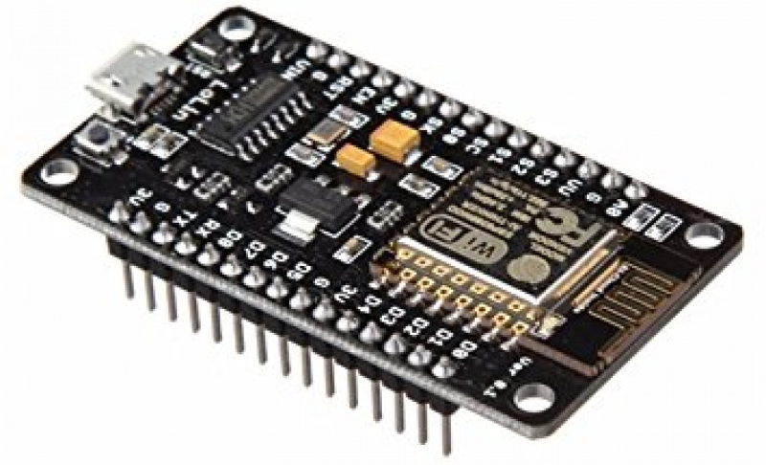
Node MCU ESP 8266 12E

Slide 10
1) NodeMCU is a low-cost open source IoT platform. It initially included firmware which runs on the ESP8266 Wi-Fi SoC from Espressif Systems, and hardware which was based on the ESP-12 module. Later, support for the ESP32 32-bit MCU was added....
2) The term NodeMCU stands for Node Microcontroller unit It has open source hardware and software environment. NodeMCU is also called as Devkit 1.0. It is on board system on chip(SOC) called ESP-8266. The ESP8266 is a low- cost Wi-Fi microchip with full TCP/IP stack and microcontroller capability.
3) The ESP8266 is the name of a micro controller designed by Espressif Systems. The ESP8266 itself is a self-contained WiFi networking solution offering as a bridge from existing micro controller to WiFi and is also capable of running self-contained applications.

Slide 11
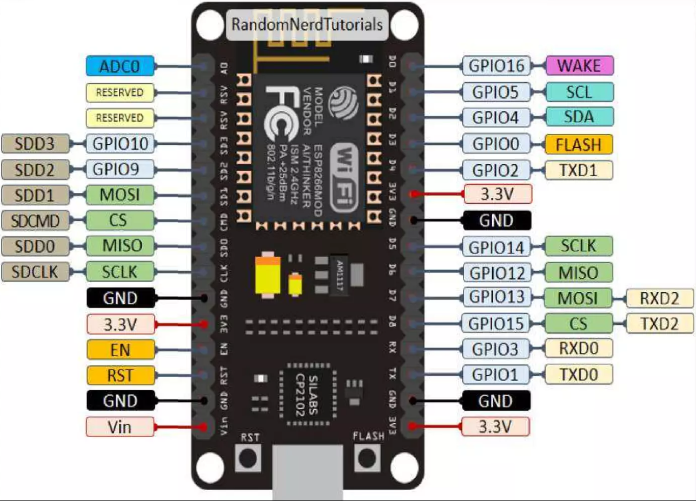
Pin diagram

Slide 12
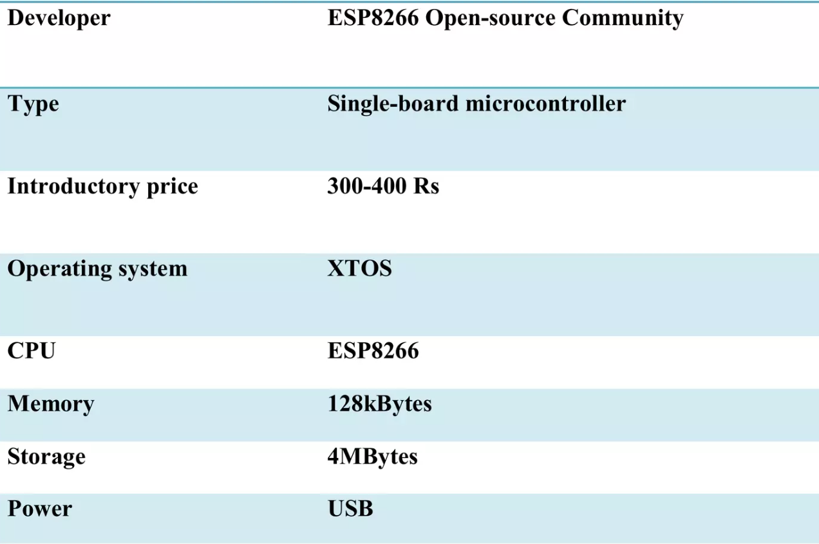
Features of node mcu

Slide 13
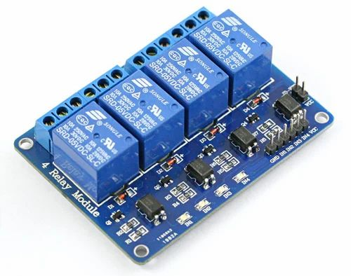
Relay module

Slide 14
INTRODUCTION
This is a 5V 4-channel relay interface board, and each channel needs a 15-20mA driver current. It can be used to control various appliances and equipment with large current. It is equipped with high-current relays that work under AC250V 10A or DC30V 10A. It has a standard interface that can be controlled directly by microcontroller.
PRINCIPLE
From the picture below, you can see that when the signal port is at low level, the signal light will light up and the opto-coupler Relay (it transforms electrical signals by light and can isolate input and output electrical signals) will conduct, and then the transistor will conduct, the relay coil will be electrified, and the normally open contact of the relay will be closed. When the signal port is at high level, the normally closed contact of the relay will be closed. So you can connect and disconnect the load by controlling the level of the control signal port.

Slide 15
Features of relay module
Size: 75mm (Length) 55mm (Width) 19.3mm (Height) .
Weight: 61g.
PCB Color: Blue.
There are four fixed screw holes at each corner of the board, easy for install and fix. The diameter of the hole is 34mm.
High quality Single relay is used with single pole double throw, a common terminal, a normally open terminal, and a normally closed terminal.
Optical coupling isolation, good anti-interference.
Closed at low level with indicator on, released at high level with indicator off.
The maximum output of the relay: DC 30V/10A, AC 250V/10A.

Slide 16
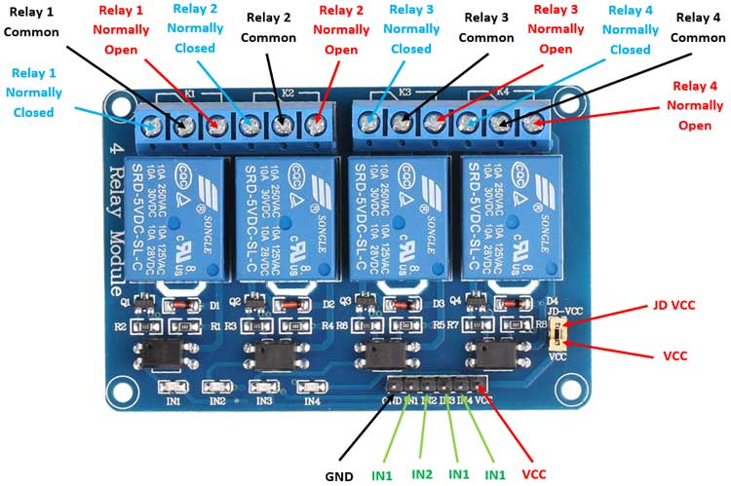

Slide 17
Pin description of relay module
1) Input: 0-5 V
2) VCC: Positive supply voltage
3) GND: Ground
4) IN1--IN4: Relay control port
5) Output: supports various types of loads
6) Connect a load, DC 30V/10A, AC 250V/10A

Slide 18
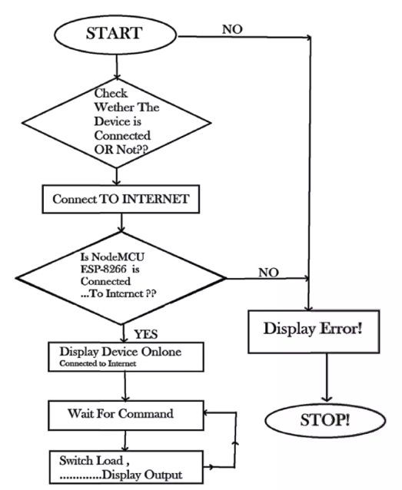
Flow chart of programme

Slide 19
advantages
1. Savings:
Smart thermostats and smart light bulbs save energy, cutting utility costs over time. Some home automation technologies monitor water usage, too, helping to prevent exorbitant water bills. Certain devices even offer rebates.
2. Convenience:
Because home automation technology performs rote tasks automatically, end users experience great convenience. Lots of smart gadgets are compatible with one another, and you can set different triggers between devices to automate regular home processes. For instance, you could set your smart locks to turn on your smart lighting when you unlock the front door.

Slide 20
3. Control:
Consumers also choose smart home devices to better control functions within the home. With home automation technology, you can know what's happening inside your home at all times.
4. Comfort:
Some people use smart technology to record shows or to play music throughout the home. Connected devices can also help create a comfortable atmosphere they provide intelligent and adaptive lighting, sound, and temperature, which can all help create an inviting environment.

Slide 21
applications
1. Heating, ventilation and air conditioning (HVAC):
It is possible to have remote control of all home energy monitors over theinternet incorporating a simple and friendly user interface.
2. Lighting control system:
A "smart" network that incorporates communication between various lighting system inputs and outputs, using one or more central computing devices.
3. Occupancy-aware control system:
It is possible to sense the occupancy of the home using smart meters[14] and environmental sensors like CO2 sensors,[15] which can be integrated into the building automation system to trigger automatic responses for energy efficiency and building comfort applications.

Slide 22
4. Appliance control and integration:
With the smart grid and a smart meter, taking advantage, for instance, of high solar panel output in the middle of the day to run washing machines.
5. Home robots and security:
A household security system integrated with a home automation system can provide additional services such as remote surveillance of security cameras over the Internet, or access control and central locking of all perimeter doors and windows.
6. Leak detection: smoke and CO detectors.
7. Home automation for the elderly and disabled.

Slide 23
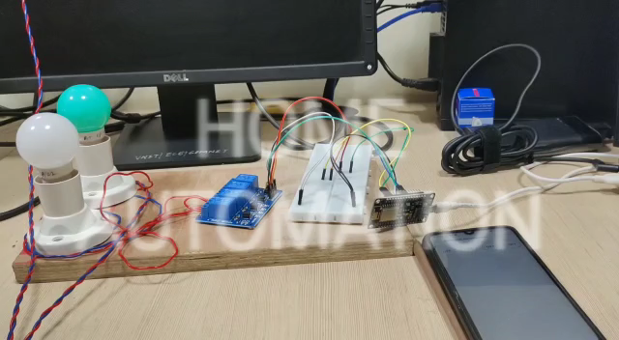
Video demonstration

Slide 24
conclusion
While wearing down this endeavour we have grabbed a lot of finding out about various modules being used in this errand. We are glad we can Built this Project as a part in this endeavour and set up new musings. Additionally, we might want to include that home computerization is the fate of places of new world
Home automation is a resource which can make home environment Automated. People can control their electrical devices via. Smartphone These home automation devices and set-up controlling action through mobile. In future these products may have high potential for marketing.

Slide 25
Future scope
1) The going with stage for home robotization advertise will happen subject to a couple of key overhauls in the progression open in Automation, for example, improvement in Wireless Automation blueprints and moreover bringing down of regard appears as the market starts perceive Home mechanization use in more noteworthy volumes
2) Big associations like Philips, Siemens and Schneider will as time goes on bring out truly mass market mechanization things with interfacing with UI in any case at lower esteem point as contrast with today, and more people will be able to bear the cost of the things.

Slide 26
3) Solution commitments will bit by bit move to an all the more straightforward structure, where next to two or three key parts, customers will have the ability to buy and use the Automation things themselves without the guide of any specific ace.
4) Future Scope for the home automation system involves making homes even smarter. Homes can be interfaced with the sensors including the motion sensors, light sensors and temperature sensors and thus this may provide the automatic toggling of the devices according to the conditions.

Slide 27


